Slide 1
PROJECT ON CENSONO
BY
MATUR INNOCENT JOSHUA

Slide 2
INTRODUCTION
Censono is a chat website that enables it users to hold conversations between one another. The conversation can be a one-to-one conversation, one-to-many or many-to-many conversations. These conversations can be done either between two individuals (without third party access), or within multiple individuals as a discussion.
I decide to develop a website that will enable easy navigation and easy access to other users far from one another.
Censono can be used as a tool to connect and bring family, friends and people together.

Slide 3
ACTIVITIES LIST
Design web page layout to suit different dimensions.
Design Navigation menus to provide access to other pages or contents of a page.
Create forms to accept inputs from the user.
Design navigation to the following pages in the header section if the home page of the website.
Design a footer bar on the home page that displays the copyright information of the company.
Optimize all the images used in the Web Pages.
Create registration page, index.html where new users can register themselves in order to have access to the system.
Create Login page, index.html to checkmate who is eligible to access the website’s chat section.

Slide 4
ACTIVITIES LIST (Cntd)
Create chat page, messages.html to enable users to hold conversation between one another.
Create profile page section, in messages.html to view and edit your profile information.
Create chat friend profile page section in messages.html to view profile of the person you are chatting with.
Create the home page, index.html, where users are taken first when they launch the website and provided with the login or register options. This page also contains navigation links to the following pages:
Home
About
Contact
Create Create the about page, about.html; to show information about Censono.
Create the contact page, contact.html to show contact information of Censono.
Create an external stylesheet to format all Web Pages of the Censono website.

Slide 5
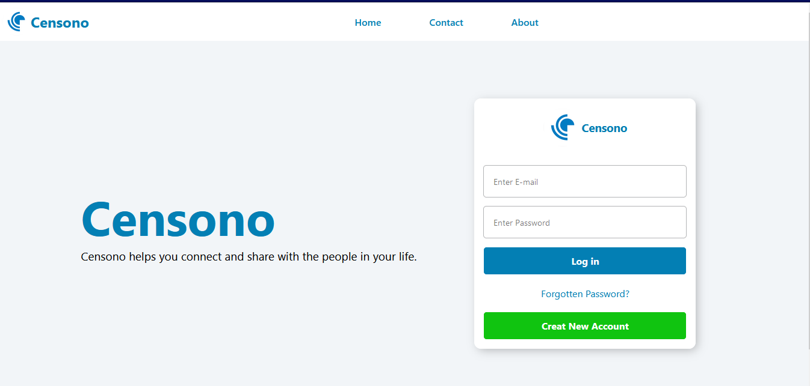
HTML PAGES

Slide 6
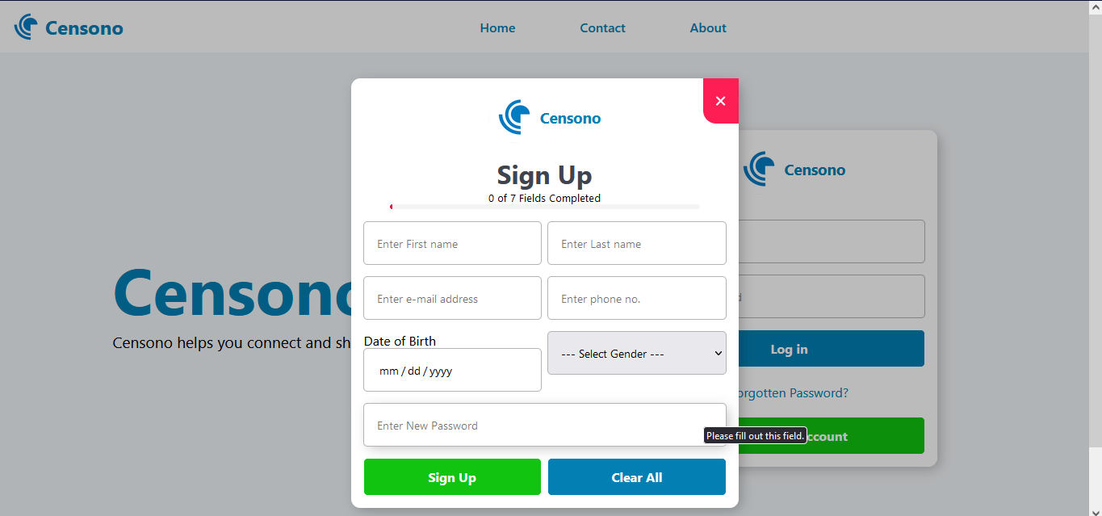
HTML PAGES

Slide 7
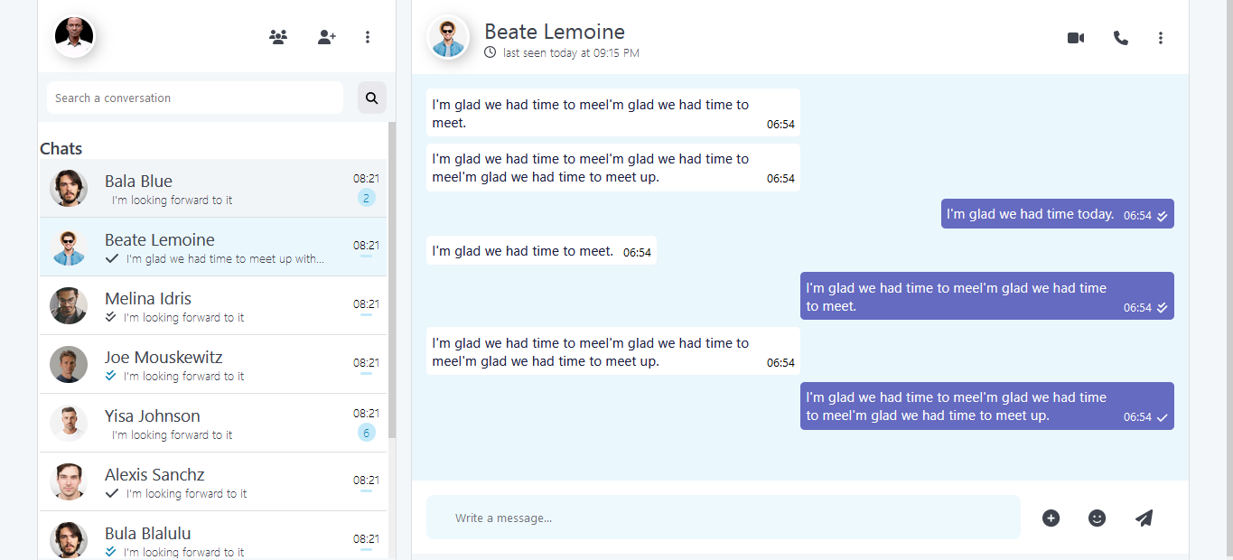
HTML PAGES

Slide 8
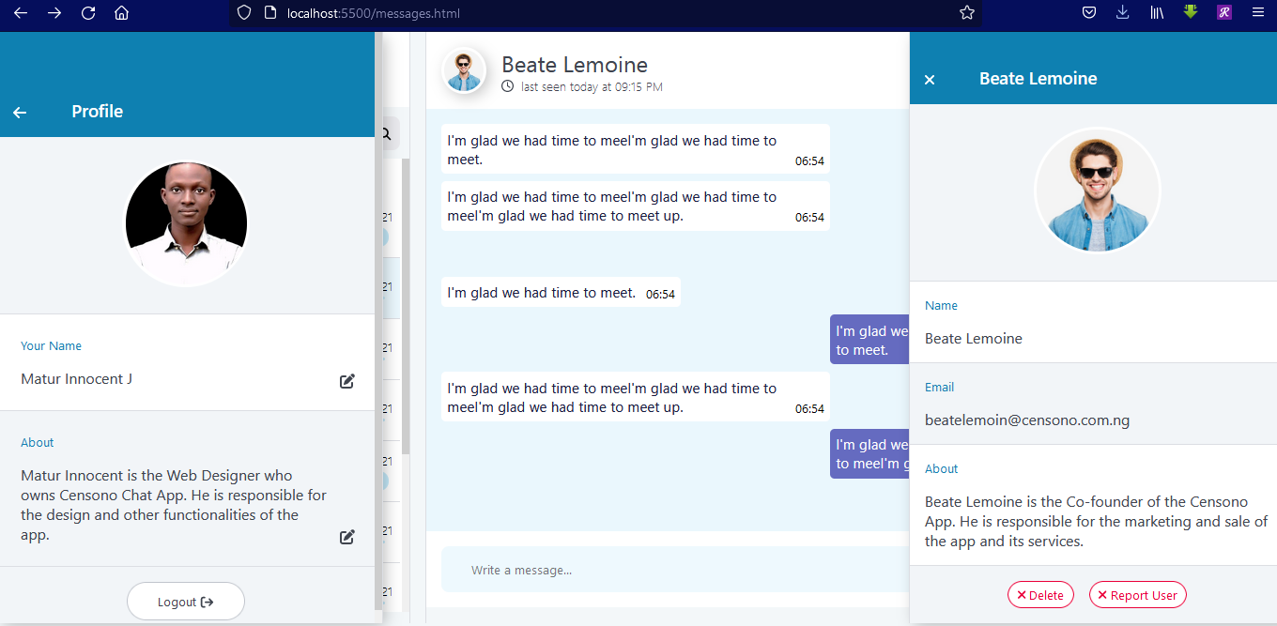
HTML PAGES

Slide 9
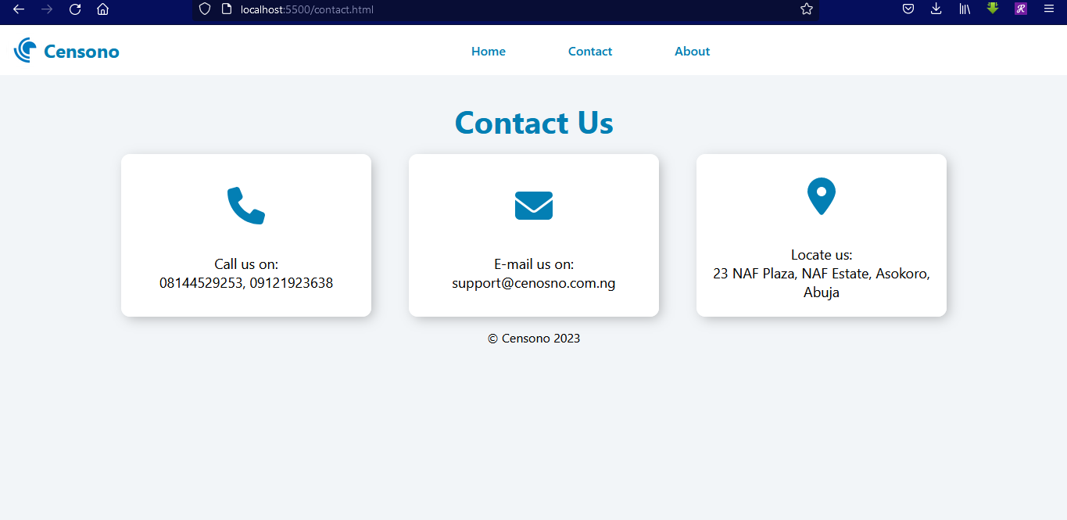
HTML PAGES

Slide 10
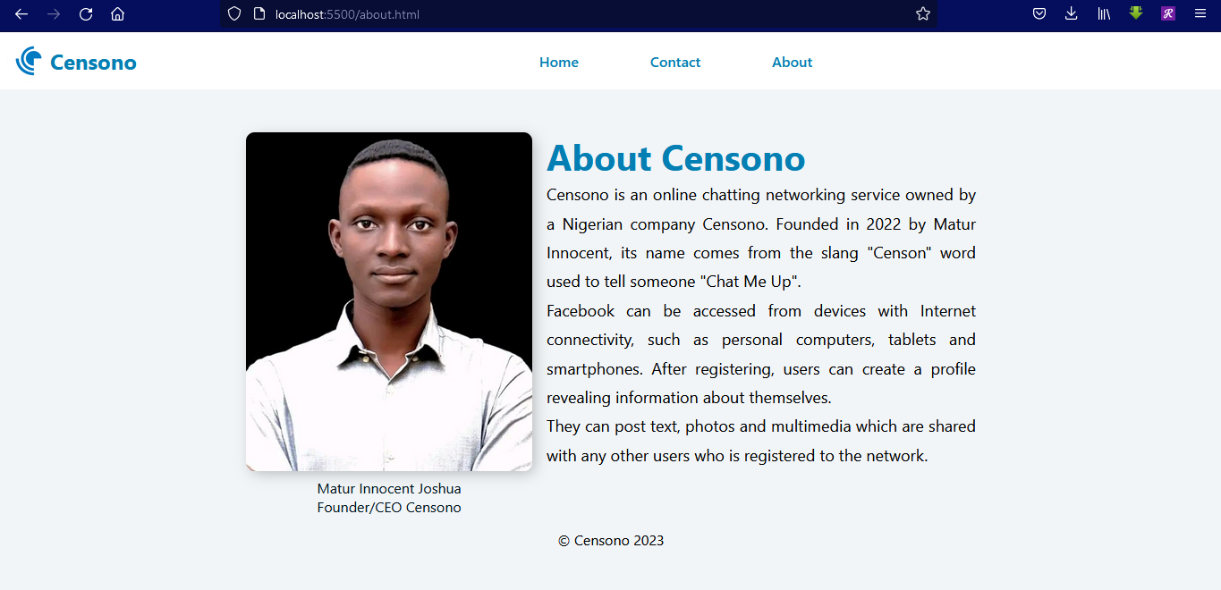
HTML PAGES

Slide 11
JAVASCRIPT VALIDATIONS
The registration page uses JavaScript to validate and display to the user the progress of their registration
After the user clicks the Plus (+) icon beside the input field, more options pop up.
After the user clicks on their own profile picture at the top left of the page, their profile displays.
When the user clicks on the picture (at the top) of who they are chatting with, the user’s profile opens.
The user closes either of the profile pages by clicking the arrow left (←) button or the close (X) button at the top of the profile.
After the user clicks on the register button, the registration form comes up.
The user can click the close button at the top right of the registration form to close the form.
JavaScript checks the registration form and indicates to the user if all the fields are filled or not.

Slide 12
SYSTEM CONFIGURATION
Hardware
:2.0 GHz Intel Pentium Processor or higher
: 2GB RAM or more
: 120GB Hard Drive or later
: Optical Wheel Mouse
: QWERTY Keyboard
: 15" Color Monitor
Operating System
: Microsoft Windows 7 or later
Software
: Mozilla Firefox Browser V16 or later

